Slide 1
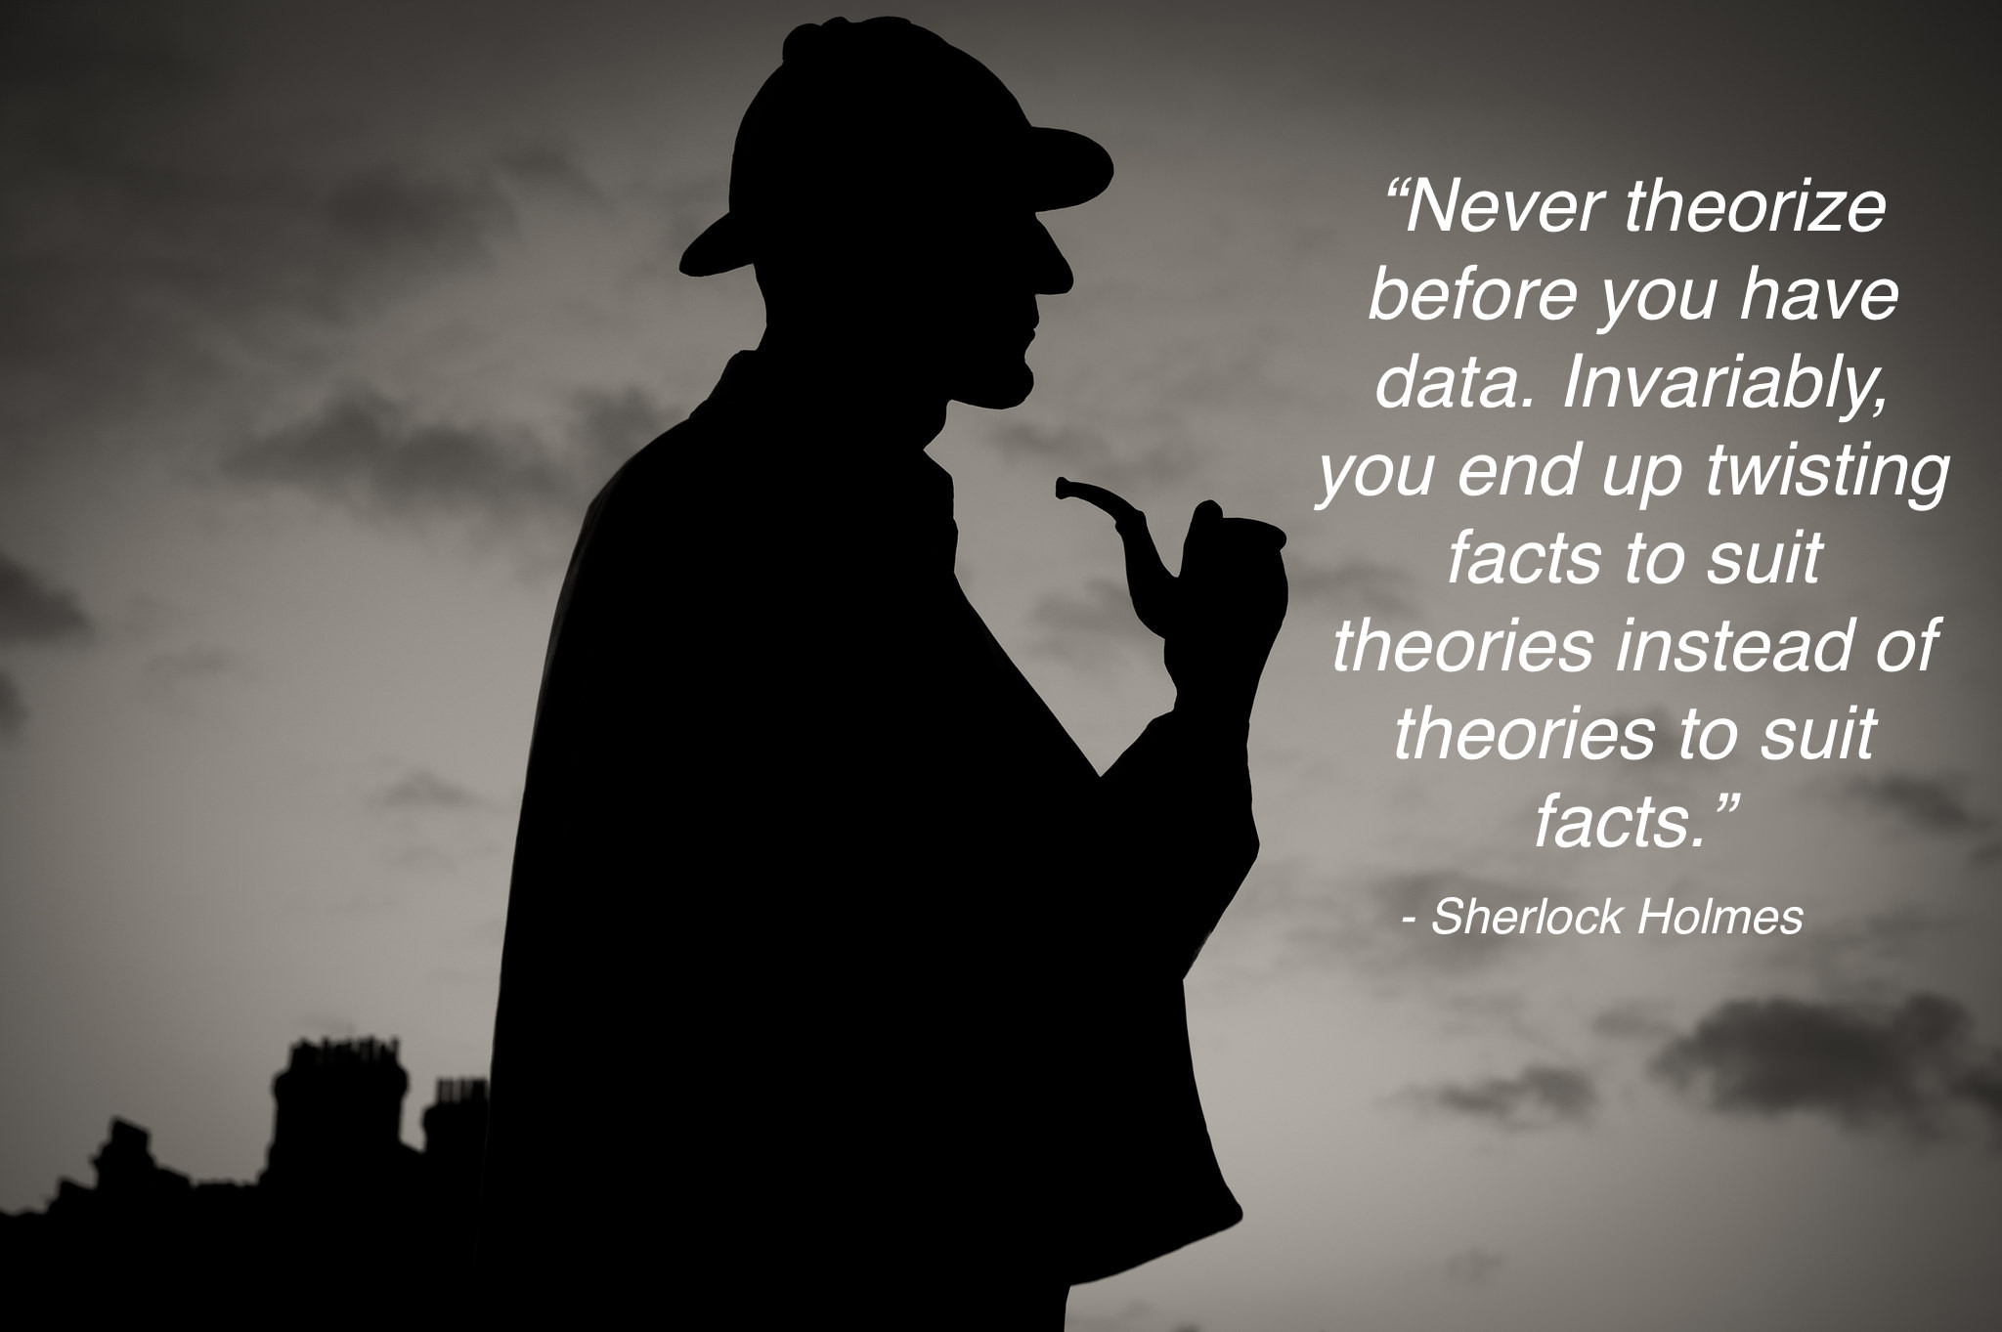
Notes:
Sherlock Holmes is a fictional detective created by British author Arthur Conan Doyle. -Wikipedia

Slide 2
Module 02: Data Collection & Data Ethics/Morals

Slide 3
Data Collection
(Primary) Data Collection typically involves 3 stages:
1) Design of the Questionnaire or Surveys
It includes determining the length of the survey (like how many questions), order of the questions, and more importantly the wording of the questions.
E.g. “Don’t you agree that it is about time to overrule the decision of abolishing policy ABC…”
2) The Process or Medium of Collecting Data
Will it be in paper survey or online, or which platforms you use etc.
3) Entering and Cleaning of Data
Believe it or not, it takes up about 60-65% of statisticians’ time to do data-cleaning! (FYI: 20-25% on analysis including coding, 10-20% writing reports/doing presentations.)

Slide 4
Issues Related to Data Collection
There are two biases arising from data collection:
1) Response Bias – the bias stemming from the “wrong” response
It arises primarily from misleading questions or the question is sensitive or offensive to a point the subjects have to make up some fake answers.
2) Non-Response Bias – the bias stemming from no responses
The causes are similar to above, but the outcomes are slightly different.
It arises from hard-to-understand questions (so giving up or leaving blank is more reasonable) or the subjects just do not want you to know the truth.
MLO: Identify and justify the response bias and non-response bias.

Slide 5
Primary Data Source
There are two typical data sources.
Primary Data is the data generated by end-users.
Pros: You can do whatever you want
Cons: it is very time-consuming and costly
Note: Almost everything we have discussed so far in M02 and M03 are steps or procedures of producing primary data, including observational studies and experimental studies.
That said, most of us will never use or collect primary data, unless you are part of a research team.

Slide 6
Secondary Data Source
Secondary Data is data that end-users get from another person or it is directly downloaded from various websites.
It seems nice and fast, but we do not know…
1) if observations were independent to each other
2) if a decent sampling process was used, so potential selection bias
3) if the survey was worded properly, so potential response bias
4) if non responses were removed or improperly imputed*, so potential non-response bias
In other words, be very careful when using secondary data because…
MLO: Identify and criticize primary and secondary data sources.
Notes:
* Imputation is a technique to insert a non response based on various methods.

Slide 7

Are We Automating Racism?
Takeaway: Garbage in, garbage out!
Notes:
URL: https://www.youtube.com/watch?v=Ok5sKLXqynQ
Duration: 22m53s

Slide 8
Cognitive Biases
Besides all statistics related biases, there are a few Cognitive Biases that you might want to be aware of. Here are few I find important in this area.
1) Confirmation Bias – people choose to focus on things that agree with their belief (related to the TED Talk by Julia Galef)
2) Survivorship Bias – people make conclusion based on what they see, without questioning if they are seeing the whole picture
3) Availability (or Recency) Bias – people choose to focus on the latest information (and tend to forget other older information)
4) Dunning-Kruger Effect – most people think they are smarter than they actually are (and see things thought that tinted lens)

Slide 9
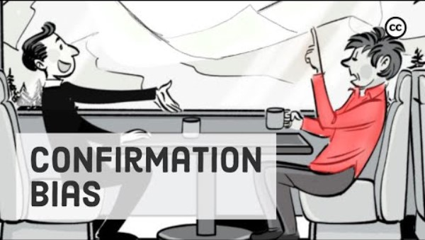
Confirmation Bias
Notes:
URL: https://www.youtube.com/watch?v=Kho5KvPBDSw
Duration: 4m53s
Please watch it in your own time.

Slide 10

Survivorship Bias
Notes:
URL: https://www.youtube.com/watch?v=ZyLVIvBidIA
Duration: 4m52s
Please watch it in your own time.

Slide 11
Laws, Ethics and Morals
Here is just Michael’s way of seeing things… so it could be wrong!
1) Laws are set of rules (called laws) to guide citizens of a country (or society) to differentiate what is right from what is wrong → country specific
2) Ethics are set of rules or guidelines (called code of ethics/conduct or sometimes policies) to guide employees of a particular profession to differentiate what is right from what is wrong → profession or area specific
3) Morals are beliefs of a person (or a small group of people, like family or religion) of how to behave, how to improve upon ourselves, and how to make the others and surrounding better → person specific
Note: The morals of a person are often shaped by their upbringing and experience.

Slide 12
Laws, Ethics and Morals - Examples
Is spitting on the street ok? Under what situation would it be ok?
Is lying/exaggerating in your resume ok? Under what situation would it be ok?
In school, is using your friend’s answer as your own ok?
Is using ChatGPT answer as your own ok? Under what situation would it be ok?
Is bullying a person ok?
Is helping others bullying a person ok? Under what situation would it be ok?
Is killing a human being ok?
Is helping others killing a human being ok?
Is killing a terminally ill human being ok? Under what situation would it be ok?

Slide 13
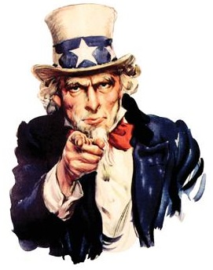
Final Thoughts
A few things to note in this up-and-coming data science or data analytics field…
There are neither laws nor ethics governing our behaviour on…
a) how data are created (obs. study vs. expt. study),
b) how much documentation is provided (indep. obs., and discussion of biases),
c) the privacy/confidentiality of the data,
d) validity of the analysis results disseminated
As a future data analyst or data scientist, you are the gate-keeper of data ethics.
So, hold on to your moral compass, without which human beings will be lost!

Slide 14
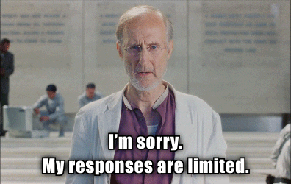
Any Questions?

